Slide 1
Being a Computer Science Student
Prof Lachlan MacKinnon
Head of Computing and Information Systems
University of Greenwich
London, UK

Slide 2
Overview
Making the Transition
Behaviour
Expectations – Yours
Expectations - Ours
Industry Issues – employability
Computer Science and IT trends
How do you get there?
Scholarly and Academic Practice

Slide 3
Making the Transition
Why are you here?
Subject, employment prospects or just next thing?
Why is this place different?
Optional, not mandatory, on both sides
Adult workplace, not playground
Community of scholars
Risk-free testing and development of skills and knowledge
Multi-cultural environment for learning

Slide 4
Behaviour
Adult workplace environment, so:
Show respect to all, colleagues and staff
Do not treat labs and classes as playgrounds
Bullying and harassment are unacceptable
Turn up on time
You are responsible for your own behaviour!
If you disagree with these:
You don’t have to be here!
Infringement will result in disciplinary measures

Slide 5
Expectations - Yours
You can expect:
To be treated with respect, as an adult
To be given opportunities to learn through online (TEL) and face-to-face methods
To be provided with current learning materials, assessments and feedback at all levels
To be given a timetable of contact hours for lectures, labs, etc., and opportunities for guided self study and coursework (VD)
To be supported in developing workplace skills and employability opportunities

Slide 6
Expectations - Ours
We expect you:
To treat everyone with respect
To attend classes, labs and tutorials
To read around your subject, following guidance from staff, and to be curious
To engage and take part in activities and events organised by the department
To let us know early if things are going wrong
To positively support your course and the University externally

Slide 7
Industry issues - Employability
You are joining a community subject to constant and major change
IT is the fastest growing subject area, employer and money-earner in the world today
BUT, you have to be able to keep up, which means learning new technologies for the rest of your life, and constantly being prepared for change

Slide 8
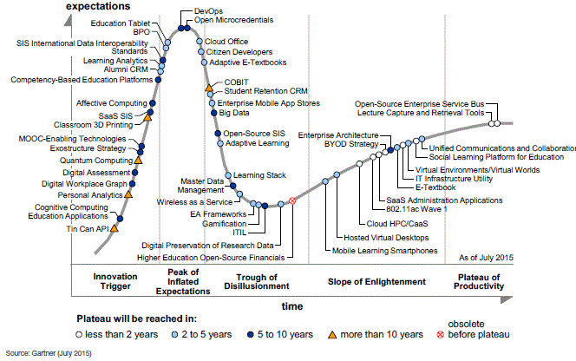
Gartner Hype Cycle – Emerging Technologies
2015

Slide 9
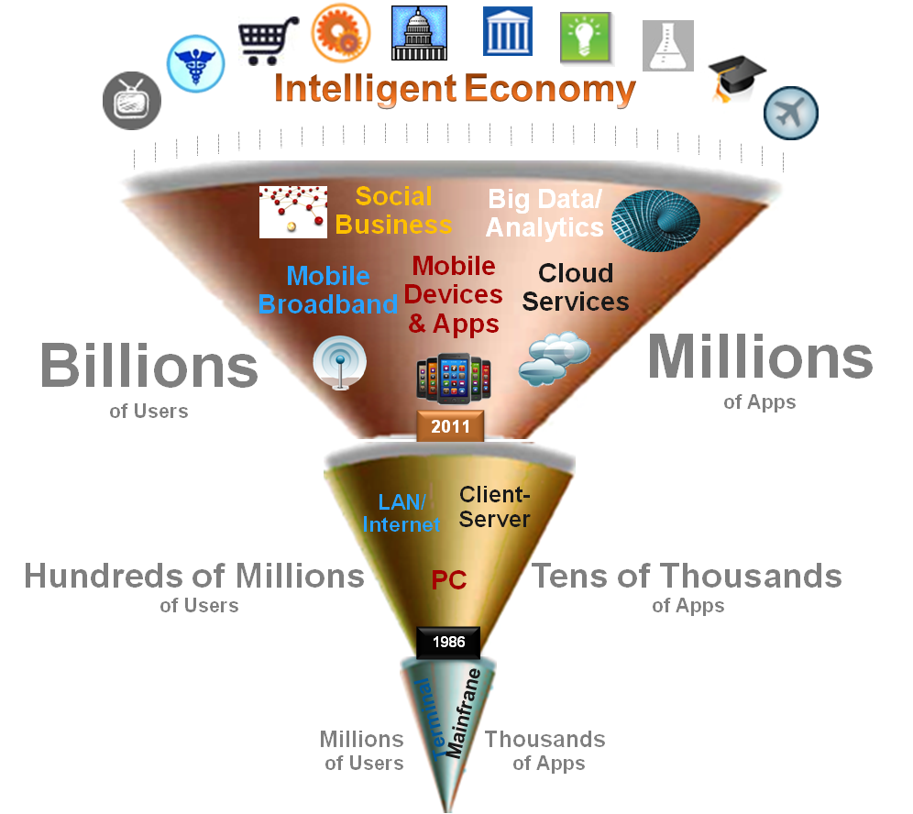

By 2020, the IT industry will be dominated by today’s new disruptive technologies…
Disruptive Technologies
Cloud computing
Mobile devices and apps
Social technologies
Big Data analytics
Internet of Things
Today = about 22% of global IT spending
2020 = 40% of the market and 98% of growth
2020, ICT industry will generate nearly €4 trillion in spending worldwide

Slide 10

Trends - Mobile
March 2013 6/7 people on the planet had access to a mobile phone – only 4.5/7 had access to a toilet!
Facebook had 100 million mobile phone accesses per day (2010)
2013: 17.4% of web traffic came through mobile (>6% on 2012)
By 2016 the number of people accessing the Internet through PCs will shrink by 15 million as the number of mobile users increases by 91 million

Slide 11


Trends - Mobile
In 2013, both the Apple App store and Google Play exceeded the 50 billion downloads threshold.
In both cases, half of the total downloads occurred in the preceding 12 months.
IDC estimates that smart mobile devices will generate 57% of the IT industry’s overall growth worldwide (Gens, 2013)
98% of mobile apps not used one year after release

Slide 12

Trends - Cloud
Characteristics that distinguish from traditional resource provision models
On-demand
Internet based
Resource-pooling
Infinite capacity
Demand-driven billing
Public
Private
Hybrid

Slide 13
Trends - Cloud
Traditional
IT Spending
Cloud Spending
Cloud is key for digital innovation
Traditional SW and HW spending transforming into SaaS, IaaS
Cloud is an enabler of mobility and Big Data, an enhancer of IoT

Slide 14


Trends – Big Data Analytics, Data Visualisation
IBM - ‘every day, we create 2.5 quintillion bytes of data” i.e. 90% of world’s data created in the last two years – growing by 50% per year! (ACM)
In 2010 Eric Schmidt said “Every 2 Days We create as much information as we did up to 2003”.
Gartner predicts that 4.4 million IT jobs globally will be created to support big data, with 1.9 million of those jobs in the US (Lundquist, 2012).

Slide 15

Big Data – how it is changing society
Analysis of anonymised mobile phone data - track commuter journeys from home to work, re-routed buses reduced commuter time by 10% in one city.
Understanding patterns of movement through analysis of cell tower hopping can tell you how disease will spread
Typical patterns of behaviour e.g. daily routine, triggering health alerts if these change.
Analysis of taxi journeys in San Francisco (Sandy Pentland MIT) classify people into urban tribes and their typical behaviour – what they wear, how social they are, music they like, how much they exercise, typical health problems e.g. diabetes, patterns of health (reduce healthcare costs if problems caught early)
Personalised adverts on web, TV
Cars monitor driving habits and report to insurance

Slide 16

Trends – Internet of Things
Objects, people, animals etc. have unique identifiers and can communicate over a network automatically.
Cisco (2013) estimates:
The potential economic impact is as much as $14.4 trillion for private sector businesses worldwide, with:
Internet of things
“the potential to increase global corporate profits by approximately 21% in aggregate over the next 10 years”
This estimate does not include the potential value to citizens, communities and countries.
IoT solutions are mostly deployed to address issues around the supply chain, product/asset tracking, retail, healthcare, logistics.

Slide 17

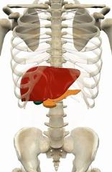
3D / 4D Printing and Market Disruption
BAE Systems have already printed a part for an aeroplane
Chinese materials firm has reportedly produced 10 3D-printed buildings (excluding the roof) in 24 hours, using a custom-built machine that outputs layers of construction waste mixed with cement (BBC April 2014).
4D printing – “over time static objects will transform and adapt”, programmable material build themselves - uses water to provide flexibility – print clothes instead of washing them, print human organs from stem cells.
Finished object will self-assemble or transform into a pre-determined form – already achieved!
Consumers will expect not to have to choose between mass produced and bespoke items - will expect personalisation on an industrial scale.

Slide 18


An Indicative Roadmap of Technologies
2014...
Cloud Computing, Mobile Apps
Some social business
Next 2-3 years ...
Big Data, Social Technologies close to mainstream
Increasing diffusion of IoT
In 5-6 years (∼2020)
Convergence of main trends
IoT & Cloud & Big Data

Slide 19

Implications for Education
We need to prepare students for jobs that don’t yet exist
Predictions in the UK (2015) – 1/3rd of jobs (10 million) are at risk of automation in the next 10-20 years – not just low skilled jobs
Good news, in the UK technology has replaced 800K jobs in the last 15 years but has created 3.5 million jobs in the same period – need workforce who can cope
Entrepreneurship is the engine of job creation – our graduates will need these skills

Slide 20
Demand: ICT Workforce Development in Europe 2012 - 2015 - 2020
Long term trend in IT market is growth in jobs and high youth unemployment in Europe
Source: Gareis, K., Hüsing, T., Bludova, I., Schulz, C., Birov, S., Korte, W.B.: e-Skills: Monitoring and Benchmarking Policies and Partnerships in Europe (Final Report for the European Commission, January 2014)
Notes:
Lachlan

Slide 21
Predicted Vacancies
Europe: At least 509,000 vacancies predicted for 2015 - UK (25%) + Germany (24%)
Europe: By 2020, 900,000 vacancies UK (27%) + Germany (17%)
Since 2007, market has annually absorbed up to twice as many new workers (growth plus replacement) as ICT/CS graduates available
Global market for IT professionals having significant emigration/immigration effects on some countries
Notes:
Zimbabwe losing graduates to South Africa, USA and Canada

Slide 22
How do you get there?
Firstly, you need a good degree
1st or 2.1 generally required for high end jobs
Secondly, you have to differentiate yourself
You’ll be competing with people with the same degree, so what else have you got?
Soft skills, employment experience, volunteering, social engagement
Placement year, Gwizards, University Societies

Slide 23
Scholarly and Academic Practice
Learn how to:
Read
Write
Present
Discuss
Debate
Interview
Learn
You need all of them to be successful here, and in the future!

Slide 24

Questions
Prof Lachlan MacKinnon
L.Mackinnon@gre.ac.uk

